Slide 1
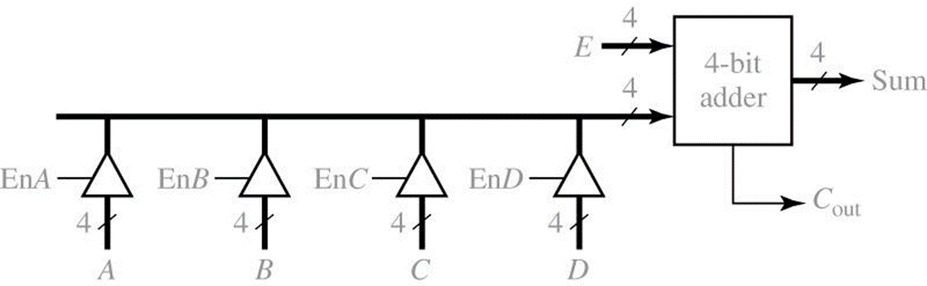
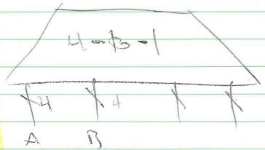
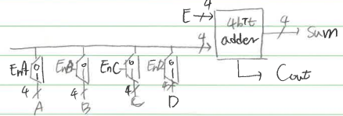
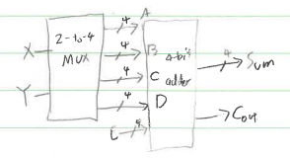
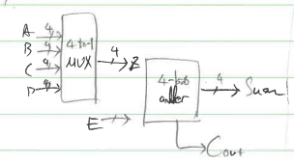
1. 4-bit adder with four sources for one operand includes four three-state buffers. Redesign this adder with a MUX and without any 3-state buffer.

Slide 2
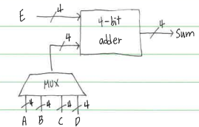
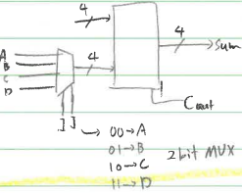
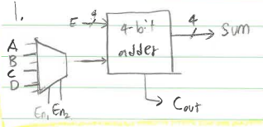
1. 4-bit adder with four sources for one operand includes four three-state buffers. Redesign this adder with a MUX and without any 3-state buffer.

Slide 3
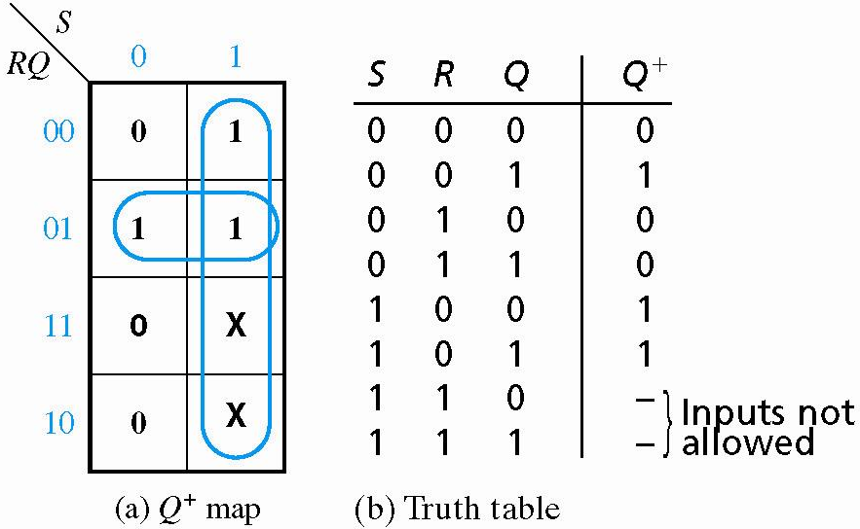
2. For SR, JK and T type flip-flops
a) Derive the characteristic and excitation equations
No Change
R=1 Reset
S=1 Set

Slide 4
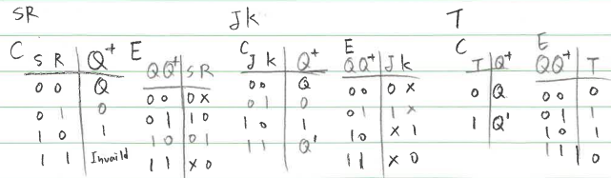
2. For SR, JK and T type flip-flops
a) Derive the characteristic and excitation equations

Slide 5
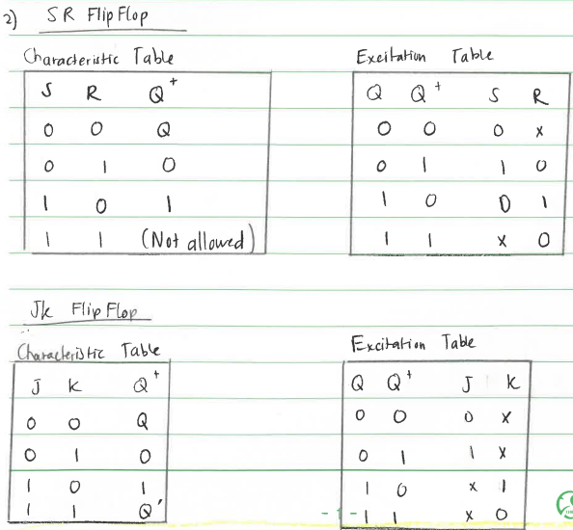
2. For SR, JK and T type flip-flops
a) Derive the characteristic and excitation equations

Slide 6
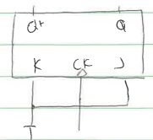
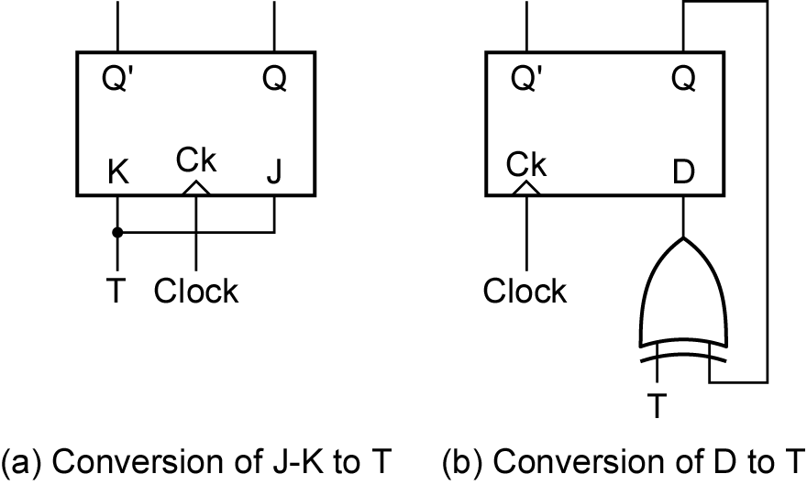
2. For SR, JK and T type flip-flops
b) Convert a JK flip-flop to a T flip-flop.

Slide 7
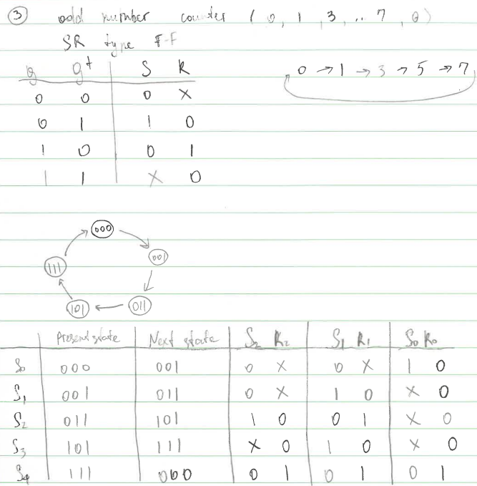
3. Design an odd number counter (0, 1, 3, …, 7, 0) with SR type flip-flops.

Slide 8
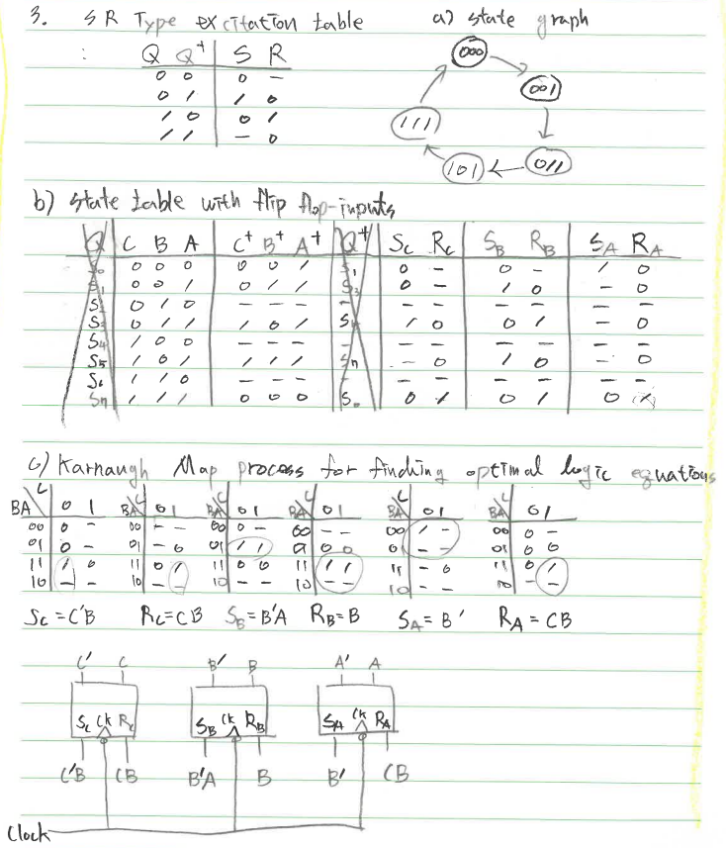
3. Design an odd number counter (0, 1, 3, …, 7, 0) with SR type flip-flops.

Slide 9
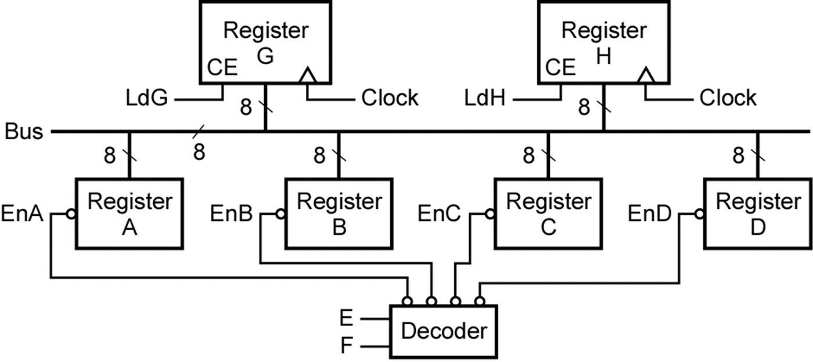

4. Compare the public transportation bus and the data transfer bus based on the figure.

Slide 10

4. Compare the public transportation bus and the data transfer bus based on the figure.

Slide 11
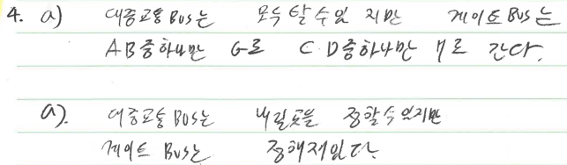
4. Compare the public transportation bus and the data transfer bus based on the figure.

Slide 12

4. Compare the public transportation bus and the data transfer bus based on the figure.

Slide 13
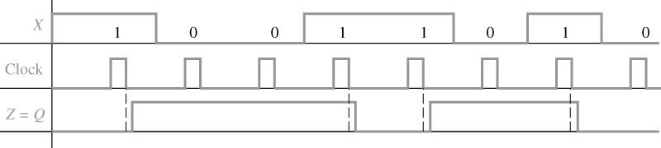
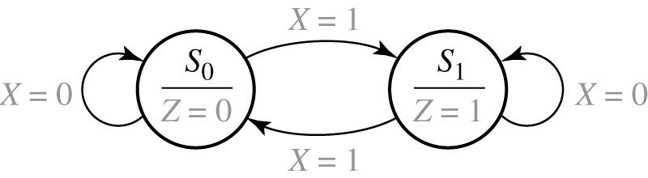
5. Design a Parity checker for every 1-byte period based on the given waveforms. (Software class)
Refer 13.1
Figure 13-3: State Graph for Parity Checker (Moore Machine)
input
Output associated with the state

Slide 14
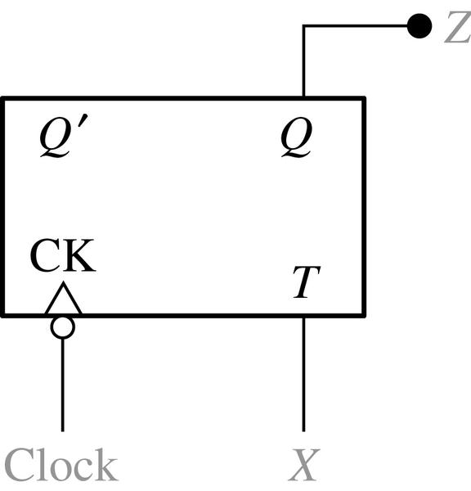
5. Design a Parity checker for every 1-byte period based on the given waveforms. (Software class)
Table 13-1. State Table for Parity Checker
Present
State
Next state
Present
Output
Z
(a)
(b)
Figure 13-4: Parity Checker

Slide 15
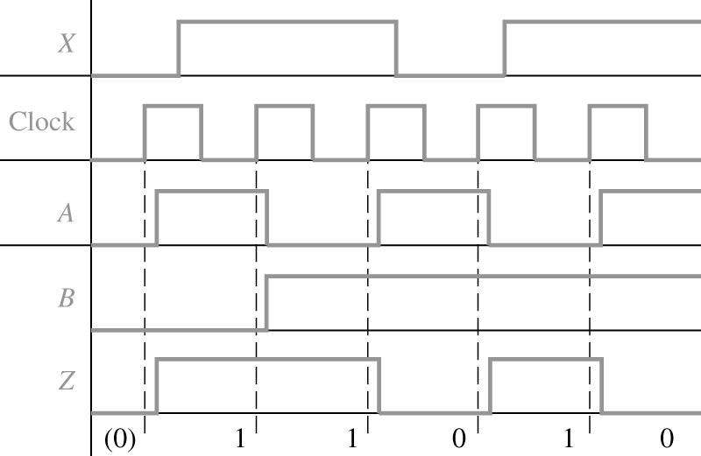
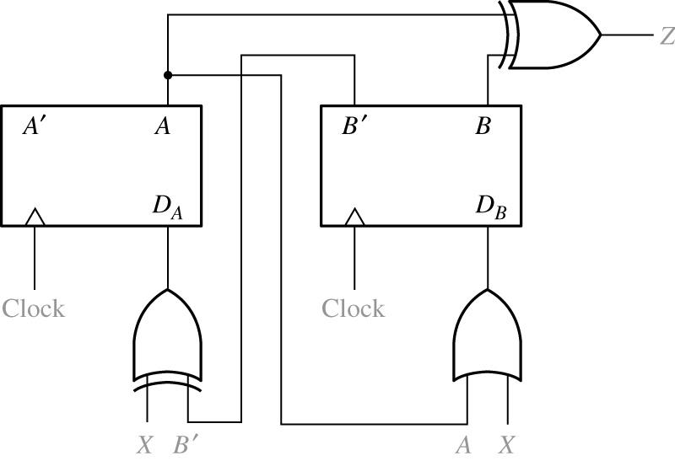
5. Design a Moore sequential circuit based on the given waveforms. (Semiconductor class)
Figure 13-5: Moore Sequential Circuit to be Analyzed

Slide 16
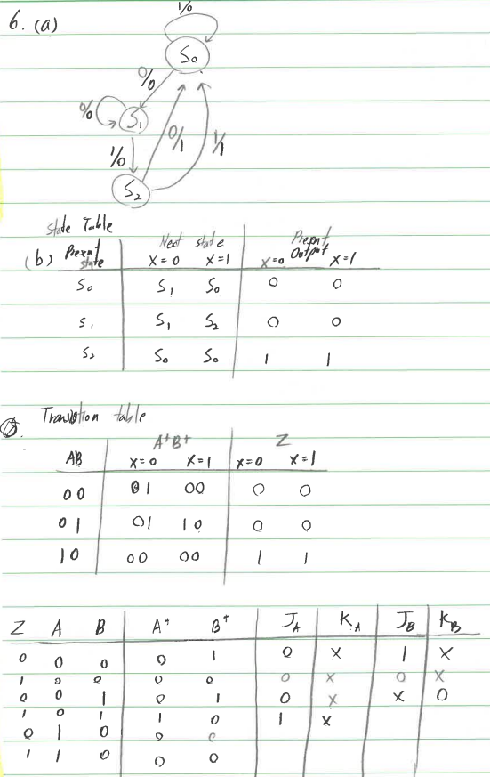
6. Design a Mealy type sequence detector for finding ‘010” OR “011” from a continuous sequential inputs with JK type flip-flops.

Slide 17
6. Design a Mealy type sequence detector for finding ‘010” OR “011” from a continuous sequential inputs with JK type flip-flops.

Slide 18
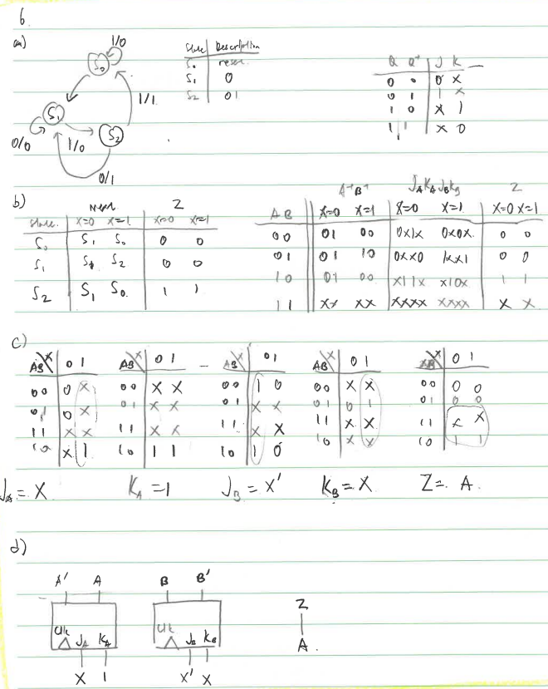
6. Design a Mealy type sequence detector for finding ‘010” OR “011” from a continuous sequential inputs with JK type flip-flops.

Slide 19
6. Design a Mealy type sequence detector for finding ‘010” OR “011” from a continuous sequential inputs with JK type flip-flops.

